Slide 1
DAILY BO REPORT
Automation Development
From repetitive manual processing to a controlled, repeatable workflow
START → Mark SECURED → PRINT
Management Overview
September 2026

Slide 2
Executive Summary
02
Why the automation was developed and what changed?
The Challenge
The Solution
The Outcome
The daily BO Settled Report required repeated manual actions, including file handling, identification of secured cases, copy/paste operations, and report preparation.
During high-cycle periods, this created unnecessary workload and increased the opportunity for human error.
A dedicated Excel VBA
(Visual Basic for Applications) Macro automation workflow was developed with a simple GUI.
The workflow controls the sequence of the daily process and automates the major repetitive steps.
A more consistent and repeatable process with less manual intervention, faster execution, and built-in step sequencing.
The Checker Staff performs the process through three controlled actions:
-START BO,
-MARK SECURED FILES,
-PRINT BO.

Slide 3
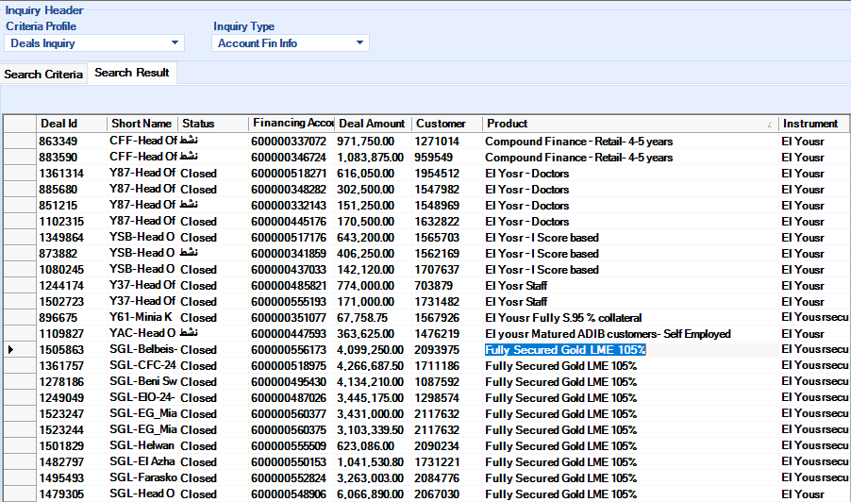
Previous Manual Process
03
Example: identifying and marking secured files manually
1
Extract / review BO data
2
Check secured status
3
Identify matching Loan A/C
4
Copy / paste or manually mark
5
Continue report preparation
Manual secured-file identification screen
Key issue: the process depended on repetitive manual actions and attention to detail.

Slide 4
What Was Improved
04
The automation targets the repetitive and error-prone parts of the workflow
Manual file processing
Secured-file identification
Copy / paste operations
Standardized the daily BO preparation and processing sequence.
Automatically matches Loan A/C against the Product Schema data and identifies Fully Secured cases.
Automated movement of BO data into the report template.
Report formatting
Process sequencing
User effort
Automated numbering, branch cleaning, borders, font formatting, and AutoFit.
GUI buttons enforce the intended order of execution.
Reduced the number of repetitive actions required from the operator.

Slide 5
Automation Logic
05
Key functions implemented in the Macro VBA (Visual Basic for Applications) workflow
1. BO Processing
2. Secured Matching
3. Report Generation
• Processes the daily BO data
• Applies the required data-cleaning steps
• Removes unwanted / irrelevant records according to the existing workflow
• Prepares the data for the settled report
• Sorts the LME data dynamically
• Reads Loan A/C from the Product Schema
• Checks the Clean/Secured field
• Selects accounts marked “FULLY SECURED/”
• Matches Loan A/C with BO LME/CAR data
• Applies grey highlighting across the data row
• Creates the BO Settled report sheet
• Transfers LME and CAR data
• Generates numbering dynamically
• Cleans branch names
• Applies formatting and borders
• AutoFits columns and completes the report

Slide 6
Before vs. After
06
Operational comparison
AREA
BEFORE
AFTER
Secured files
Manual identification / marking
Automatic Loan A/C matching + highlighting
Report preparation
Multiple repetitive actions
Automated processing and transfer
Formatting
Manual cleanup / formatting
Standardized formatting + AutoFit
Process control
Operator-driven sequence
GUI-controlled sequence
Error exposure
Higher due to repeated manual actions
Reduced through repeatable logic
Time / effort
More operator involvement
Less manual intervention

Slide 7
Management Benefits
07
The value is primarily operational: consistency, control, and reduced manual effort
Reduce human mistakes
Improve speed & efficiency
Standardize the process
Less manual copying, matching, marking, and formatting.
The repetitive processing steps are executed automatically.
The same workflow and logic are applied each day.
Reduce cognitive load
Improve process control
Create a scalable foundation
The operator focuses on the business process rather than repetitive mechanics.
The automation provides a base for further reporting enhancements.
The GUI enforces the intended sequence of actions.

Slide 8
Built-In Controls
08
The automation is designed to make the daily process repeatable and easier to operate
Step Gating
Explicit Data Matching
START BO is available first; MARK SECURED FILES becomes available after successful processing; PRINT BO follows after secured-file marking.
Secured status is not based on visual inspection. Loan A/C is used as the matching key against the Product Schema data.
Consistent Formatting
Error Feedback
Report formatting, numbering, branch cleaning, borders, and column sizing are handled by Macro code.
If a step fails, the GUI reports the failed stage and prevents the workflow from silently continuing.
REPEATABLE • CONTROLLED • LESS MANUAL

Slide 9
New Automated Workflow
09
One controlled sequence from BO preparation to final report
START BO
MARK SECURED FILES
PRINT BO
EXIT
Prepare and Update
New BO Data
Match Loan A/C
and mark Fully Secured
Generate and format
the final report
Close the automation
workbook
The interface starts with only START BO enabled. Each completed step unlocks the next action.
CONTROLLED SEQUENCE

Slide 10
DAILY BO REPORT
Automation Development
Management Takeaway
A repetitive daily reporting workflow has been converted into a controlled, repeatable automation process — reducing manual intervention while improving consistency and operational efficiency.
START → Mark SECURED → PRINT
Prepared for Management | September 2026

